Slide 1
Introduction To GPU Optimization For Analytic Throughput In R
Matt Gilliam
Data Science Indy
9/11/2014

Slide 2
Outline
Background of the GPU (graphics processing unit)
General Purpose Computing Frameworks
Why GPU?
R Solutions
Yeah But…
Windows Box R/GPU Example

Slide 3
Background of the GPU
1980s
Primary use for accelerating draw function of lines, fill, arcs.
Limited general purpose computing.
1990s
Expansion of suppliers in 2D acceleration chips
Mid-90s entered the first 3D graphics chips
OpenGL (open standard API) - appeared in the early 90s
Implemented in C and be called in any standard language
DirectX/Direct3D (Microsoft) - reliance on COM

Slide 4
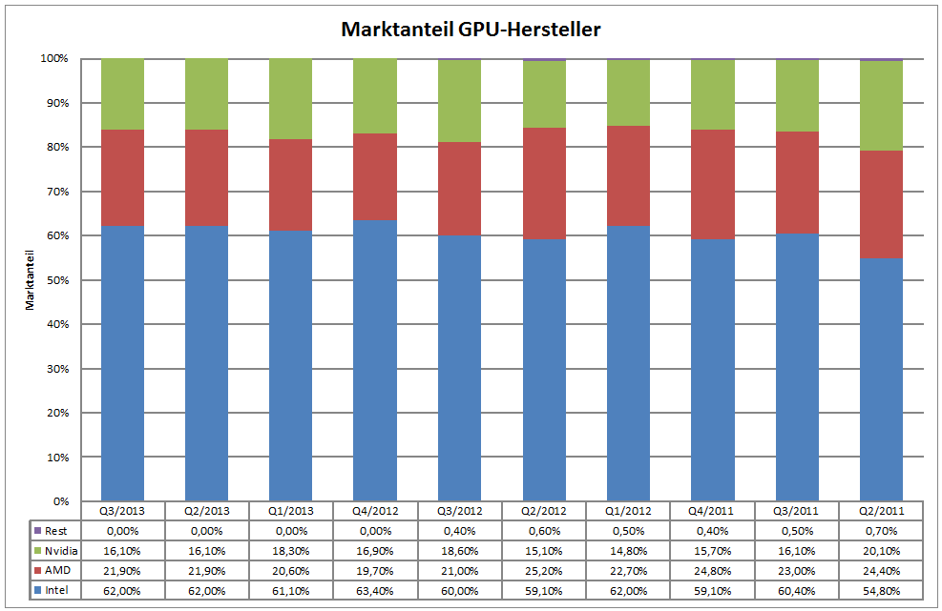
Background of the GPU cont.
Early 2000s
Nvidia - Programmable shading
ATI R300 - Could implement looping and floating point math
Now
2006 - Nvidia GeForce 8 series
Could be used for generic stream processing making it more accessible for general purpose computing

Slide 5
GPU Classes
Dedicated graphics cards
PCIe
Integrated RAM
Integrated graphics solutions
Within the motherboard as a part of the chipset
Share system RAM
Hybrid solutions
Typically seen in the low-end personal computer market
Stream Processing and General Purpose GPUs
Used for high throughput calculations with embarrassingly parallel workload with SIMD (single instruction, multiple data) implementation
External GPU
Small market subset for use when internal GPU is not possible e.g. Laptops

Slide 6
General Purpose Computing Frameworks
CUDA (Compute Unified Device Architecture)
Nvidia specific devices
CUDA 6.5 released August ‘14, includes visual profiler
In C/C++ & Fortran
OpenCL - Framework for writing programs that execute across heterogeneous platforms CPUs, GPUs, DSPs, and FPGAs. Language based on C99.

Slide 7
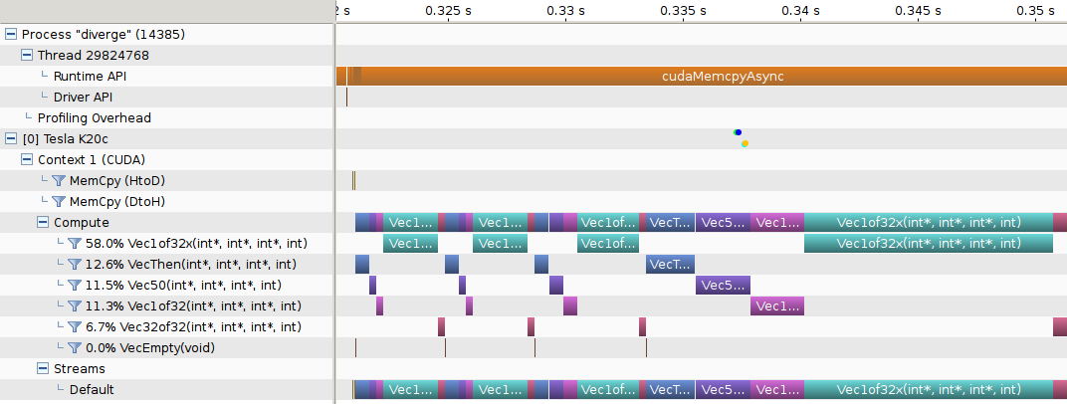
Visual Profiler

Slide 8
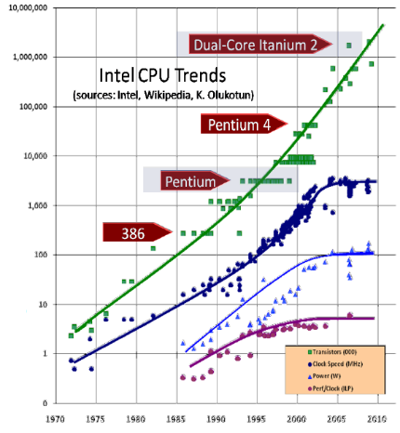
Why GPU?
Clock speed saturates at 3 to 4 GHz.

Slide 9
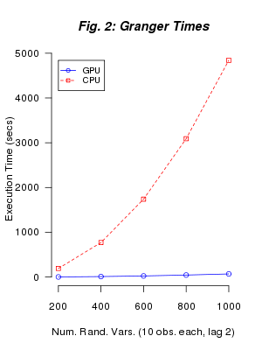
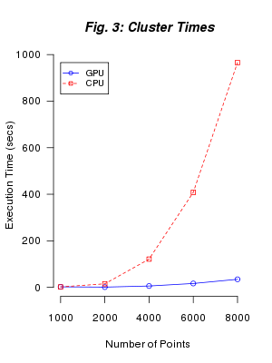
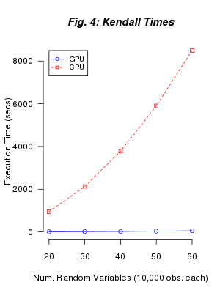
Benchmarks…and lies

Slide 10
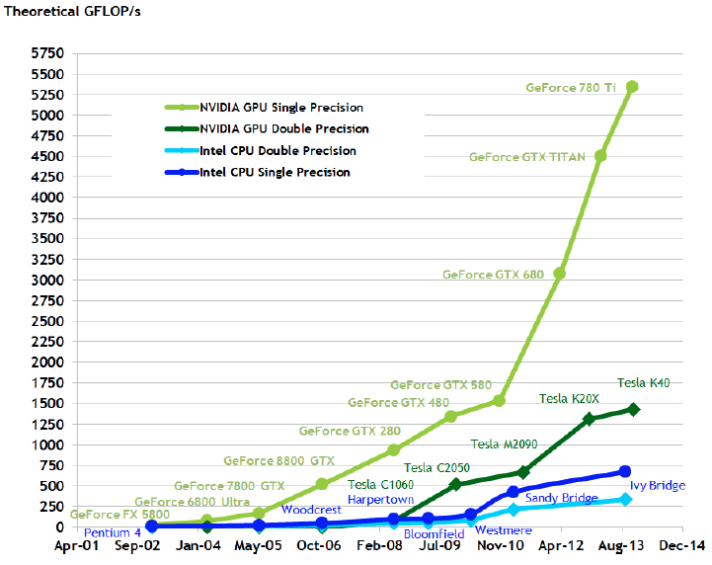

Slide 11
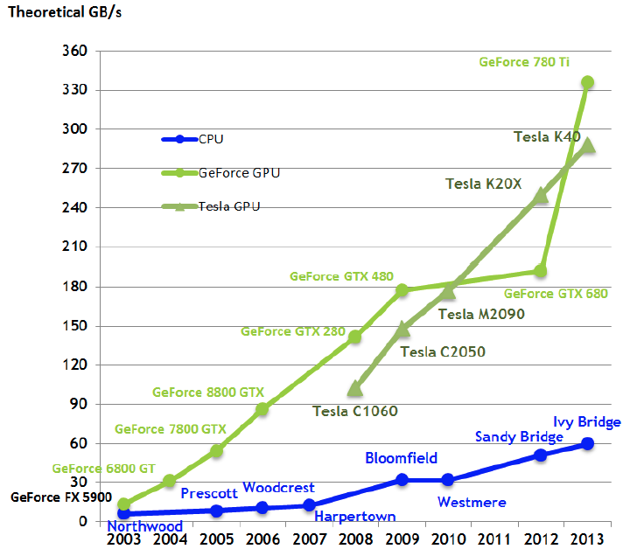

Slide 12
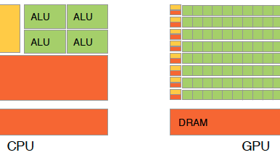

Slide 13
Examples of Current Applications
Grid computing
Lattice gauge theory
Fuzzy logic
Monte Carlo simulation
Quantum mechanical physics
Computational finance
Neural networks
Database operations
Password cracking

Slide 14
Unix Packages
Gputools - Variety of matrix functions
cudaBayesreg - rhierLinearModel from the bayesm package for statistical analysis of fMRI voxels
Gputools - Data-mining algorithms which are implemented using a mixture of nVidia's CUDA langauge and cublas library
permGPU - Permutation resampling inference in the context of RNA microarray studies
HiPLARM - High-Performance Linear Algebra using the PLASMA / MAGMA libraries from UTK, CUDA, and accelerated BLAS

Slide 15
Unix Packages cont.
OpenCL - Provides an interface to OpenCL
ROpenCL - Provides more robust functionality than OpenCL package
Gcbd - implements a benchmarking framework for BLAS
Magma - combined CPU-GPU linear algebra, intended to be analogous to LAPACK + BLAS
Gmatrix - Operations include matrix multiplication, addition, subtraction, the kronecker product, the outer product, comparison operators, logical operators, trigonometric functions, indexing, sorting, random number generation
RCUDA - High-level interface to the CUDA SDK

Slide 16
Windows Packages ☹
Rpud - Distance matrix functions
Rpudplus - Additional functionality

Slide 17
2014 International R User Conference (6/30-7/3)
New R Packages with GPU Acceleration
waveCUDA - Discrete Wavelet Transforms
CUtil - Windows based MCMC & Bayes CUDA utility
Parmatpows - Matrix powers & Markov chains based on rdsm and gmatrix
The Arborist - Scalable decision tree implementation

Slide 18
Yeah But…
Bigmemory - Supports the creation, manipulation and storage of large matrices
Bigalgebra - Provides linear algebra functionality with large matrices
Biganalytics - Extends the functionality of bigmemory
Bigtabulate - Supports table(), split() and tapply() like functionality for large matrices
Profiling - profr, proftools

Slide 19
And what about Hadoop?...
Rmr - Hadoop map/reduce
Rhadoop - Allow users to manage and analyze data with Hadoop
Rhipe - R and Hadoop Integrated Programming Environment
HadoopStreaming - Framework for writing map/reduce scripts for use in Hadoop Streaming; it also facilitates operating on data in a streaming fashion which does not require Hadoop

Slide 20
Other Options for Parallelization
Packages in R
Snow - Cluster framework
Parallel - Management with external BLAS libraries using multiple threads to do parts of basic vector/matrix operations in parallel
Foreach - Provides a method similar to for-loops for executing R expressions sequentially or in parallel. Must register a backend to manage the execution of the loop (doMC, doMPI, doSNOW, doSMP)
Pnmath - OpenMP parallel processing directives for implicit parallelism
ParallelForest - Random forest classification using parallel computing, built with Fortran and OpenMP in the backend
McParre - Regenerative Markov chain in parallel, split it up into tours and form Confidence Intervals on parameters of interest
Nws - Provides coordination and parallel execution facilities, as well as limited cross-language data exchange
Rmpi - Provides an interface (wrapper) to MPI APIs
GPU Acceleration in Python
PyCUDA/PyOpenCL - Python library for utilizing CUDA and OpenCL
Theano - Python library for evaluating multidimensional arrays in parallel

Slide 21

Parallelization Best Practices
Loop fission - Technique attempting to break a loop into multiple loops over the same index range but each taking only a part of the loop's body
Vectorization makes loops implicit in expression

Slide 22
Example System Stats
Intel Core i7-3930K Sandy Bridge-E 6-Core 3.2GHz
64Gb Ram
2 – Nvidia GeForce GTX 770 (Kepler microarchitecture)
1Tb Samsung SSD
3Tb Western Digital HD
Windows 7 Pro
R 3.1.1 x64
RStudio 0.98.978
Rpud/Rpudplus packages

Slide 23
Resources
https://github.com/njm18/gmatrix
https://github.com/berkeley-scf/gpu-workshop-2014
http://www.stat.berkeley.edu/scf/paciorek-gpuWorkshop.html
http://cran.us.r-project.org/web/packages/gcbd/index.html
http://cran.us.r-project.org/web/packages/gmatrix/index.html
http://cran.us.r-project.org/web/packages/gputools/index.html
http://cran.us.r-project.org/web/packages/magma/index.html
http://cran.us.r-project.org/web/packages/rpud/index.html
http://cran.us.r-project.org/web/packages/ParallelForest/index.html
http://cran.us.r-project.org/web/packages/cudaBayesreg/index.html

Slide 24
Resources
http://www.nvidia.com/object/cuda_home_new.html
http://brainarray.mbni.med.umich.edu/brainarray/rgpgpu/
http://fastml.com/running-things-on-a-gpu/
http://dept.stat.lsa.umich.edu/~bobyuen/gpuwiki/
http://deeplearning.net/software/theano/#download
http://cran.r-project.org/web/views/HighPerformanceComputing.html
http://www.oxford-man.ox.ac.uk/gpuss/cuda.html
http://cran.r-project.org/web/packages/gputools/index.html
http://repos.openanalytics.eu/html/ROpenCL.html

